Slide 1

Python + FUSE
Zach Wick
Barracuda Networks / Copy.com
Notes:
Little bit about me:
- Software Engineer (I think) @ Barracuda Networks
- Work on Copy.com web + API
- previously web dev at LectureTools
- my own embedded hardware startup
- free software ideologue
- shirt rotation

Slide 2
What is FUSE?
Filesystem in userspace
An abstraction layer between non-priveleged user code and the kernel
Has been in the Linux kernel since 2.6.14
Notes:
Kernel space v. user space
- kernel modules live in “kernel space”
- “user space” is your libraries and applications
FUSE is a kernel module
- hence its “abstraction layer”/”bridge” between KS and US.
Linux-2.6.14 28-Oct-2005

Slide 3
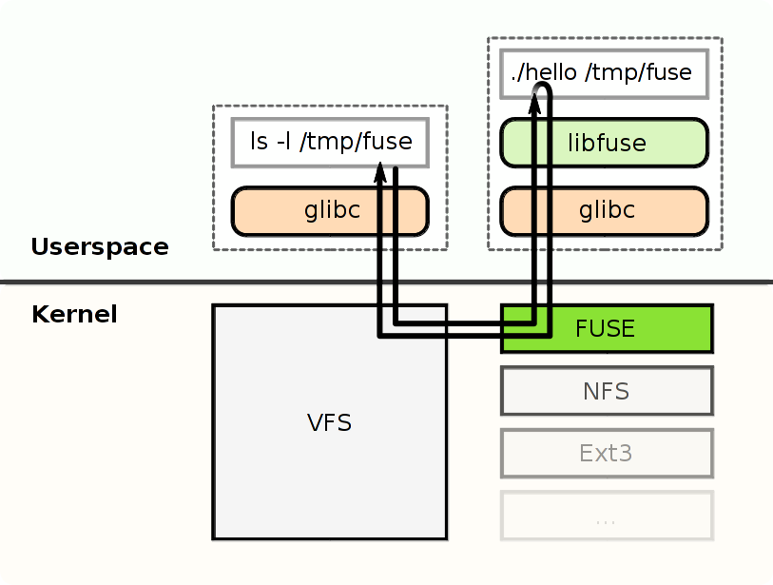
https://upload.wikimedia.org/wikipedia/commons/thumb/0/08/FUSE_structure.svg/490px-FUSE_structure.svg.png

Slide 4
Why FUSE?
It can run on tons of platforms
FUSE is an abstraction layer between a data source and a “real” filesystem
Notes:
Platforms
Linux
FreeBSD
NetBSD
Android
Mac OS X
Many more

Slide 5
FUSE examples
GlusterFS
GmailFS
GVFS
EncFS
ExFAT
WikipediaFS
You can fake cloud storage as local drives!!
  Use their APIs (or don't)
Notes:
GlusterFS – Now a RHEL product. Does some crazy backend storage stuff
GmailFS – use a Gmail account as networked storage (python)(doesn't work as of 13-dec-2009)
GVFS – virtual fs of GNOME desktop. Easy access for SFTP, FTP, WebDAV, SMB, etc.
EncFS – transparent encryption of files, using an arbitrary FUSE mnt pt as storage of the encrypted data
WikipediaFS – edit/view articles as if they are real files on disk. (python)(unmaintained, page nav difficult)
This is possible because of the role of “translation layer” that FUSE plays

Slide 6
FUSE in Practice
“Filesystem Class” methods:
  getattr,
  readlink, mknod, mkdir, unlink, symlink, rename, link, fsinit
Notes:
Filesystem Class
Getattr – get metadata on file
Readlink – return target of a symlink obj
Mknod – create a filesystem obj path
Mkdir – create a directory path
Unlink – remove any filesystem obj at path
Symlink – create a symlink
Rename – rename FS obj to new name
- works like bash 'mv'
Link – create a FS obj as a hardlink to the target
Fsinit – called at invocation of Fuse.main()
- a place to start background processes or whatever

Slide 7
FUSE in Practice
“File Class” methods:
  open, create, read, write, fgetattr, ftruncate, flush, release, fsync

Slide 8
A Contrite Example
Notes:
- Go to ~/Documents/Personal/PyOhio\ Talk/examples/hello.py

Slide 9
Hello FUSE!
4 filesystem operations
Subclass of fuse.FUSE
Note the 'file class' & 'filesystem class' are clearly seperated
Notes:
- subclass of fuse.FUSE called the 'filesystem class'
- class for file operations called the 'file class'
- optional!
- needed for reading/writing files
Getattr – get the metadata attributes on a specific file
Readdir – get the metadata attr's on a given dir
Read – read data from an already opened file
Open -

Slide 10
Copy.com and FUSE
Another cloud storage platform? Seriously?
I can't run the GNU/Linux sync agent/desktop app
I can run FUSE layers though
Sign up at https://copy.com/pyohio for bonus 10GB

Slide 11


Slide 12
Enter copy-fuse
https://github.com/copy-app/copy-fuse/
Will run on any platform that can run python and FUSE (so pretty much everywhere)
  Will run on a Raspberry Pi
Bonus GB's for pull requests (hint hint)

Slide 13
copy-fuse demo
Real time data interaction on an R-Pi!!
“stream” data (like movies/music)
Open an image
Unarchive a .tar.gz
  Ignore the scary warnings

Slide 14
Implementing a FUSE layer
You are translating filesystem operations to some service
Only implement the operations that you care about
NULL OP the rest

Slide 15
Implementing a FUSE layer
Anything can be a data source
  microblog posts as files | date of post as folders
  Contacts as files | Employers as folders
  Wikipedia articles
  A different filesystem

Slide 16
Other FUSE layer examples
https://en.wikipedia.org/wiki/GmailFS
https://en.wikipedia.org/wiki/EncFS
https://code.google.com/p/fuse-zip/
https://code.google.com/p/boxfs/

Slide 17
Questions?

Slide 18
Contact Info
zach@zachwick.com (0x3C840943)
@ZachWick (rarely used)
zwick on IRC (Freenode)
http://zachwick.xxx/public | http://git.io/⚠

